Slide 1
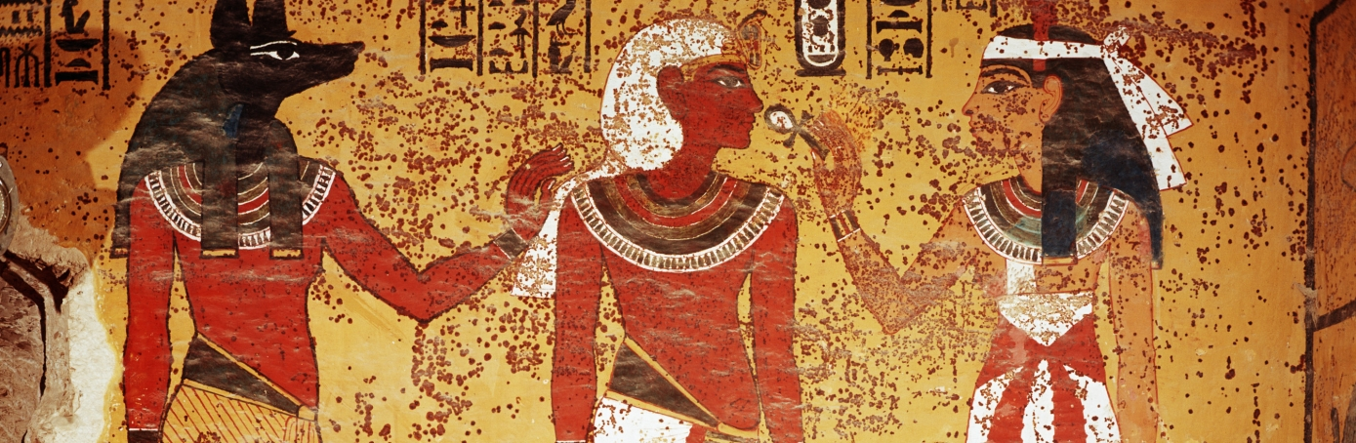
Africa: Gods, Rulers, and the Social Order

Slide 2
Ancient Egypt:
Emerged along the banks of the Nile River in Northeast Africa.
The civilizations location along the Nile allowed their agricultural society to thrive, and left them virtually invulnerable to foreign invasion.
Unlike Mesopotamia, Egypt was home to several civilizations, all of which shared common religious, political, and cultural views for 3000 years.
Its population shared a common language and world view, influenced by the realities of the natural environment, climate, and geography.
The 365-day cycle of the river’s influx became the basis of the Egyptian’s solar calendar, and the primary source of Egypt’s deep sense of order.

Slide 3
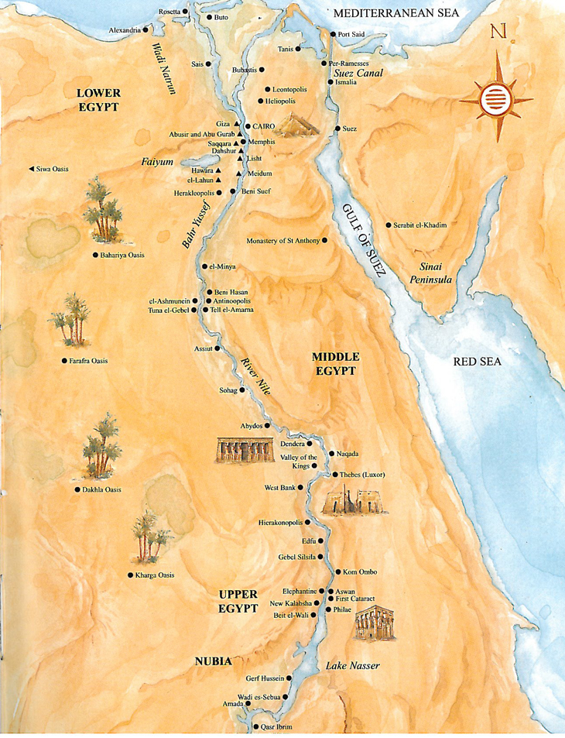

Slide 4
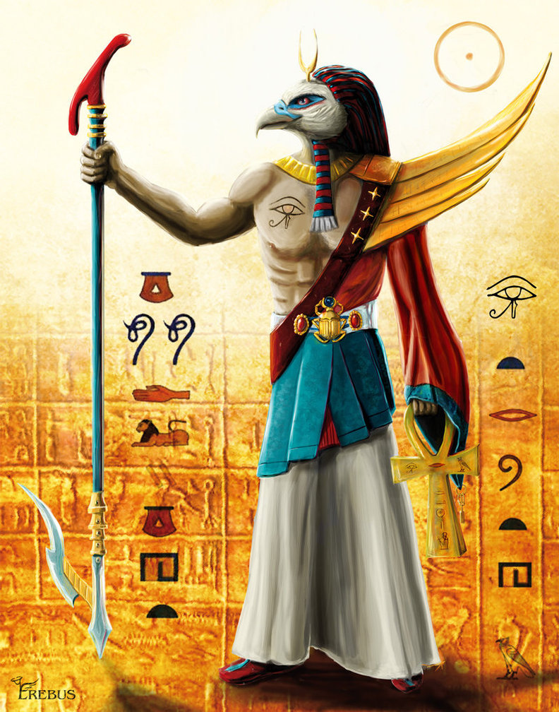
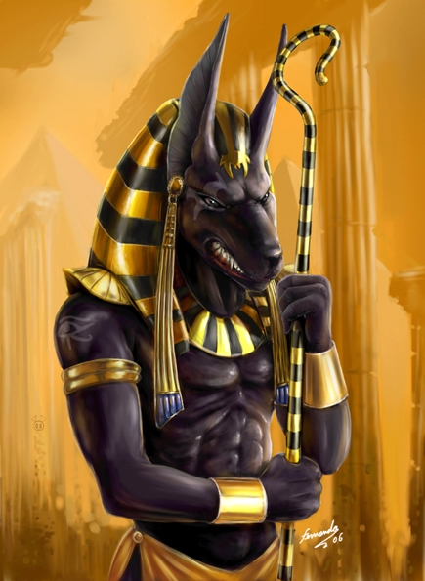
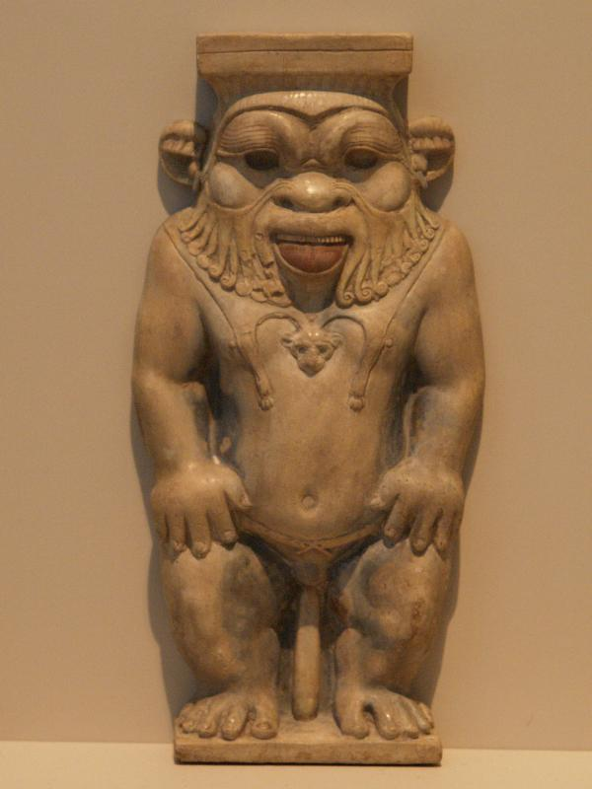
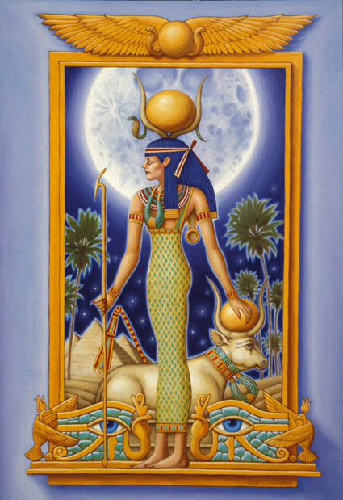
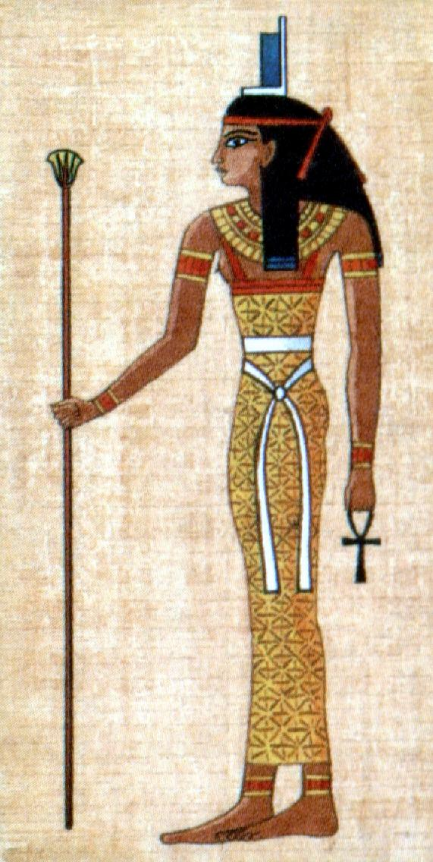
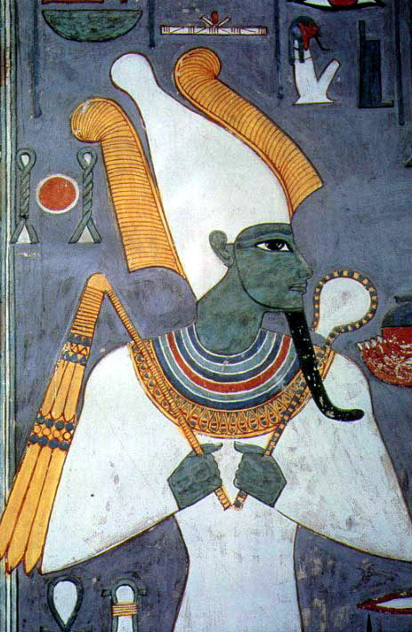
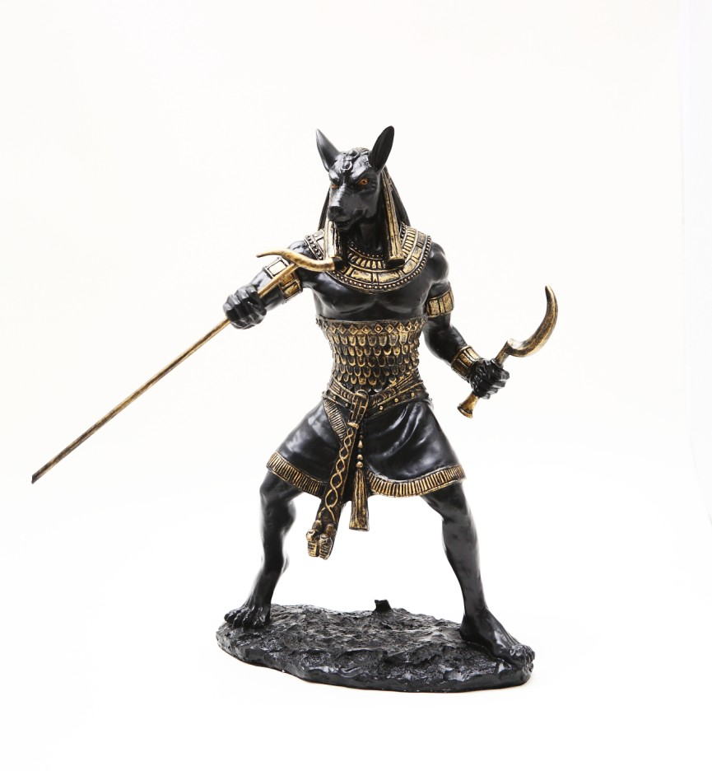
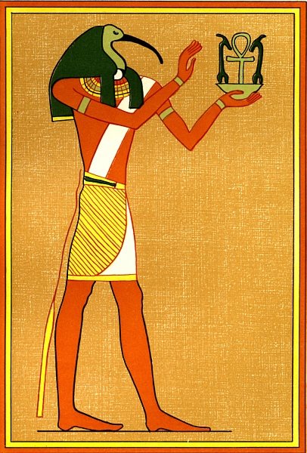
Gods of Ancient Egypt

Slide 5
Gods of Ancient Egypt
Ra/Aten/Amon- The Sun god, creator of Heaven and Earth. Represented by a falcon.
Anubis- God of cemeteries and embalmers. Represented by the jackal.
Bes- Helper of women in childbirth and the god most associated with dance. Lion-faced dwarf.
Hathor- The sky goddess. Mother, wife, and daughter of Ra. Goddess most associated with music and dance.
Isis- The goddess of fertility and the wife of Osiris.
Osiris- God of the underworld, represented by a mummified man.
Set- God of storms and violence, represented by an ass or pig.
Thoth- Inventor of writing, patron of scribes.
Egyptian religion was very complex. Every village, town, and district had its own patron deity, so the most worshipped gods and goddesses varied depending on where you were and what was most important to a specific area. For example, deities representing hunting and tribe nurturing may be important in one area, and procreation and longevity of the tribe may be most important in another. In 1352 BCE, when Egypt’s new pharaoh, Amenhotep IV initiated the worship of a single god, (Aten, the sun god), over all others, marking the one example of an attempt at monotheism in ancient Egyptian times.
Amenhotep’s religious reforms ended up being unpopular, and after his death when his son Tutankhamun rose to the throne, he restored the old gods and removed the requirement in the capital to worship Aten above all other gods.

Slide 6
Egyptian Creation Myth
From the natural elements- the sun, the Nile, and the flat land of North Africa, the Egyptians constructed their cosmology, or their origin of the structure of the universe. They envisioned their world encompassed in a singular box. (Now everyone gets a laugh as they watch Renee attempt to draw…☺).
The Egyptian creation myth describes the universe as a flat platter floating over the waters of the underworld. At the beginning of time, the waters of the Nile brought forth a mound of silt, out of which emerged the self-generating sun god Ra, and from his mouth all other gods were born, from his tears mankind was born, and from his limbs, cattle were born.
Ancient Egyptians viewed the moon and sun’s cyclical rising and setting as both the inevitability of death and the promise of birth.
The Osiris Myth- Initial stories state that after being slain, his wife Isis, with help from the god Anubis, restores his body just long enough to impregnate Isis with their son Horace. Anubis then transforms the corpse of Osiris into the first mummy, serving as the prototype for the death journey all Egyptians hope to embark on. In later Greek influenced versions of the myth state that when Isis left Osiris’s dead body in a trunk to tend to their child, Osiris’s brother Set finds the body, becomes enraged, and dismembers the body scattering the pieces throughout Egypt. Isis tracks down the pieces and buries them up and down the Nile.
Although Mesopotamia and Egypt are similar in their polytheistic beliefs, differences in the afterlife start to develop: Shadows vs. Ritual and Preparation.

Slide 7
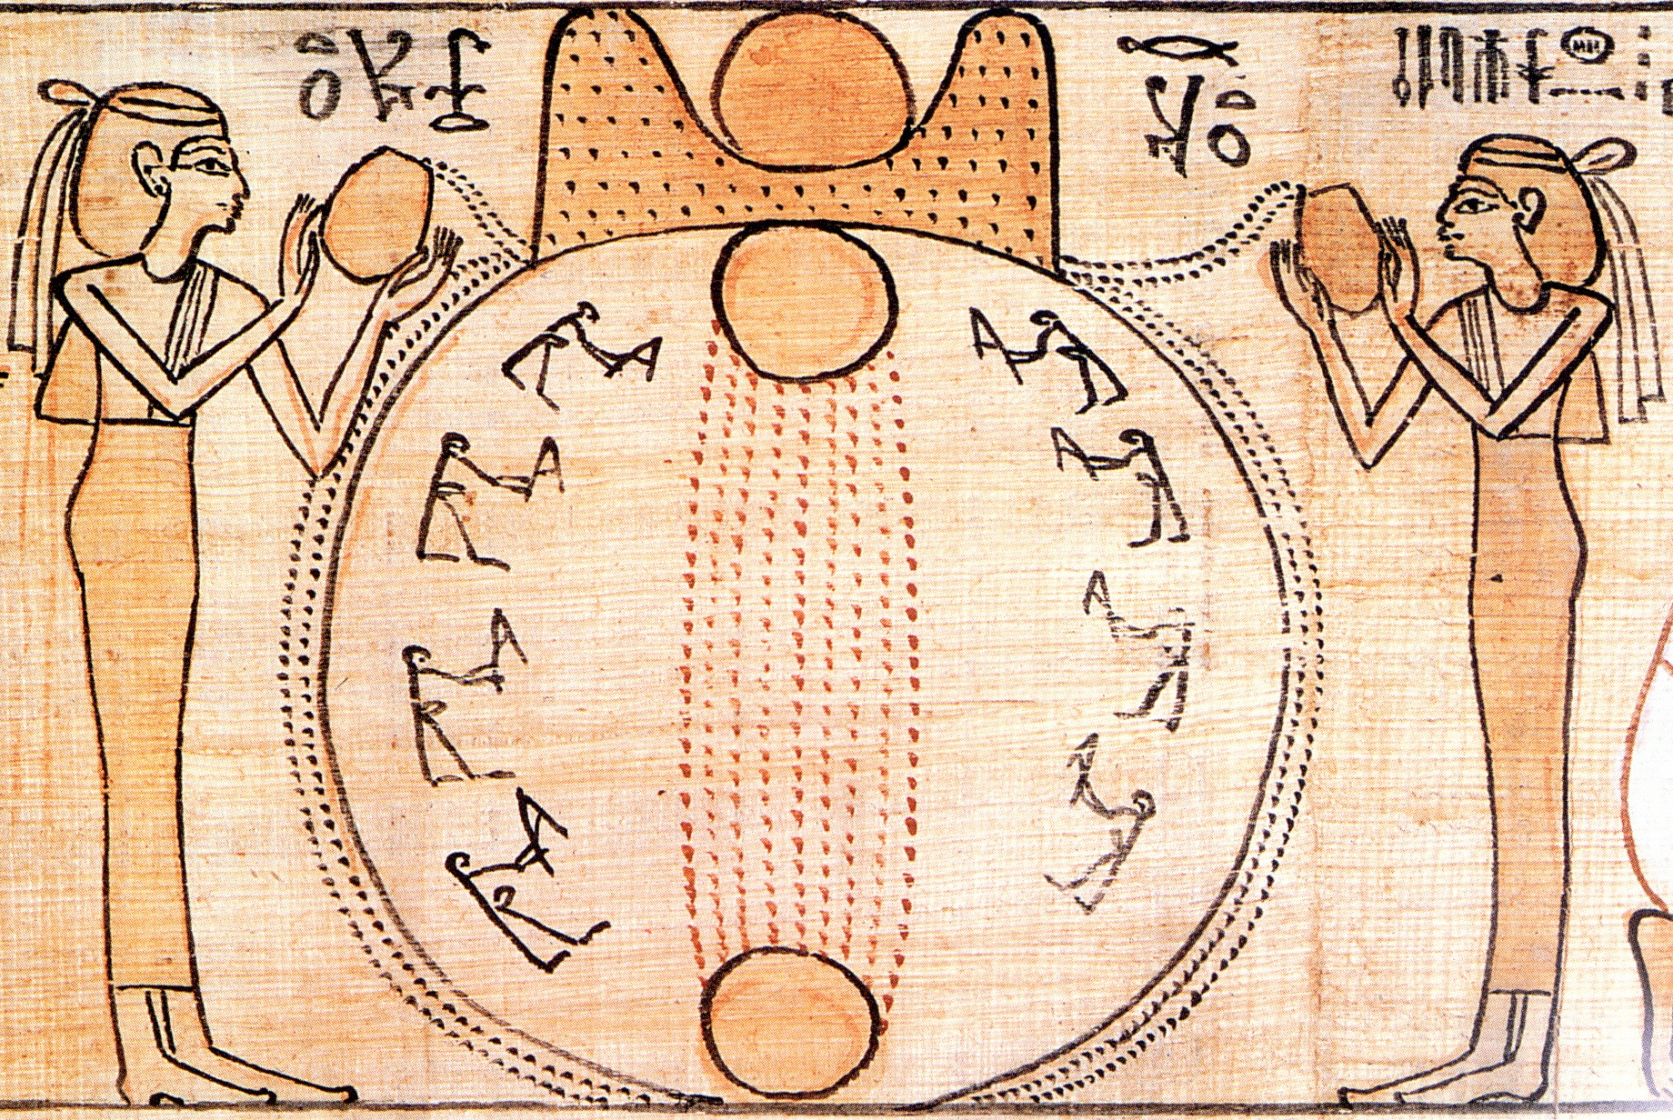


Slide 8
Rulers And Laws of Ancient Egypt
Egypt’s first pharaoh, Narmer, began his reign in roughly 3150 B.C.E. His rule brought about the union of Lower and Upper Egypt, commemorated by artists creation of the Palette of King Narmer.
Narmer’s rule initiated the first of Egypt’s dynasties, dynasties that would rule in succession for 2500 years, until the conquest of Alexander the Great in 332 B.C.E.
The dynasties perpetuated a divinely sanctioned life known as theocratic socialism, by which the harvests of the god-governed lands were shared according to the needs of the community.
Political power was often linked to power and superhuman might, as the association between gods and rulers was almost indistinguishable.
Egyptian law consisted of the unwritten decrees of the pharaoh, past down orally until their transcription during the new kingdom. “The law of the land is the mouth of the pharaoh.” No written laws have been preserved from Egypt prior to the fourth century, however, the oral traditions of passing down verbal transmissions of the rules, conventions, and customs played a vital part in establishing political continuity.

Slide 9
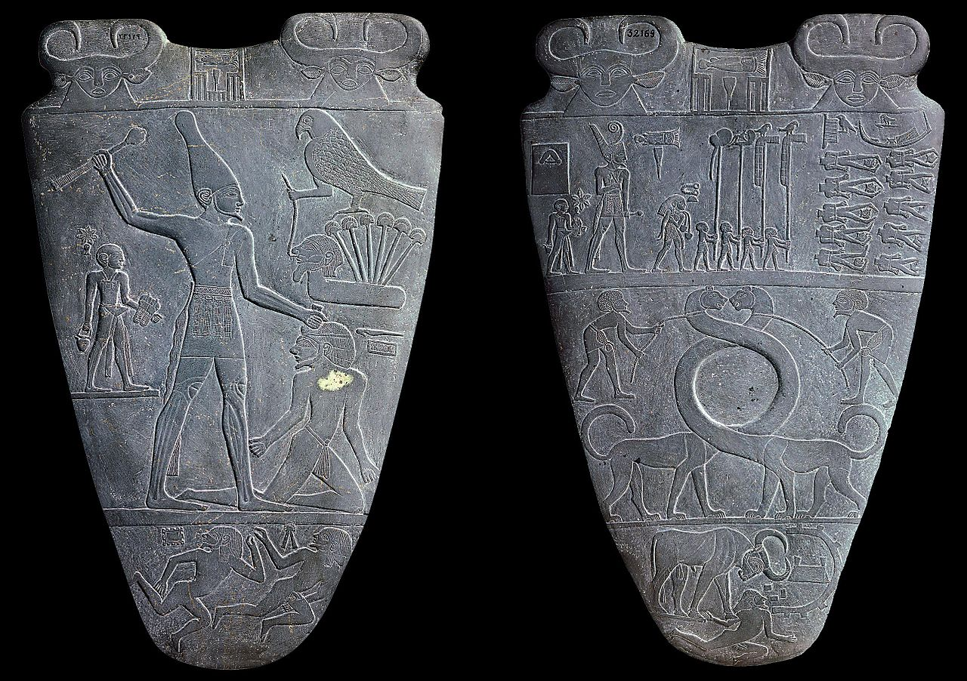
Palette of King Narmer

Slide 10
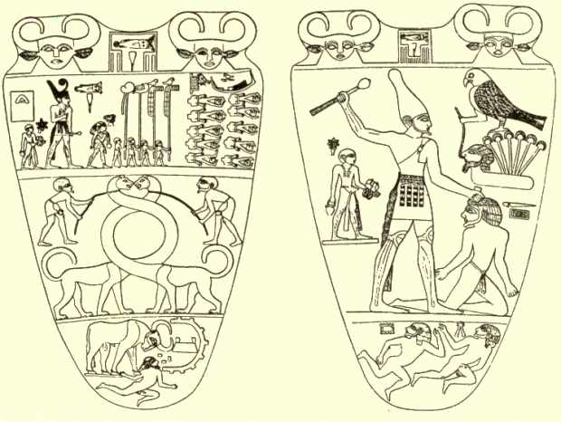
Palette of King Narmer

Slide 11
Egyptian architecture
Early Egyptian tombs were modeled on their domestic dwellings, and usually built out of mud brick.
These single story, rectangular tombs, called mastabas, consisted of an offering chamber, and a shaft that descended 100 feet below the ground. The stacking of these tombs, inspired the geometrical pyramid shape.
A workforce of 50,000 men divided into gangs of 25, labored almost thirty years to raise the Khufu pyramid.
The Great Pyramid of Khufu at the Gizeh complex consists of more than two million stone blocks rising to a height of 480 feet and covering a base area of 13 acres. The most mammoth of these structures is Khufu, which contained six million tons of stone and rose to 481 feet in height. The orientation of the pyramids align with the points of the compass.
The pyramids were built to assure the pharaoh’s comfort in the afterlife, and to serve as a home for eternity- a tribute to communal faith in the eternal benevolence of the pharaoh.
The pyramid builders were thousands of Egyptians, not foreign slaves as assumed. During the annual flooding of the Nile, when farmers could not work in the field, they went to work building the pyramids.

Slide 12
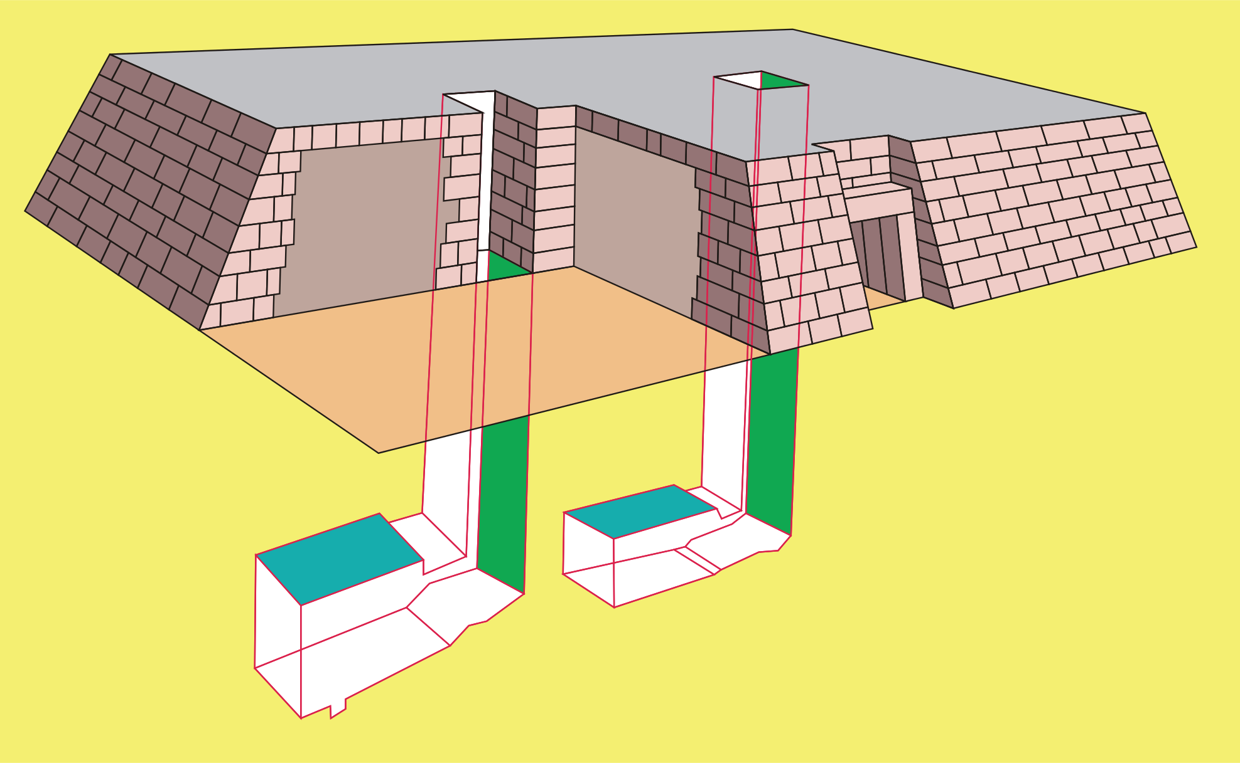
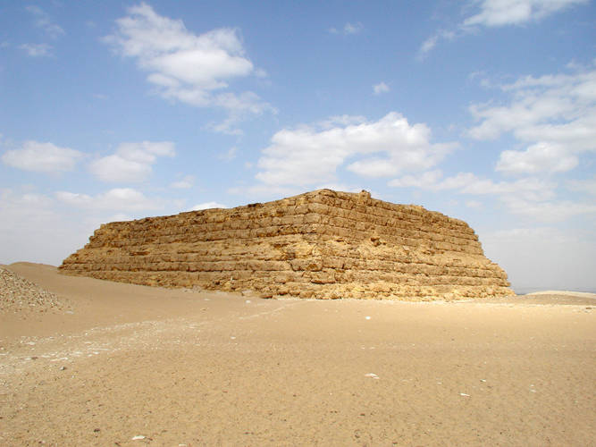
Egyptian burial chambers, or mastabas

Slide 13
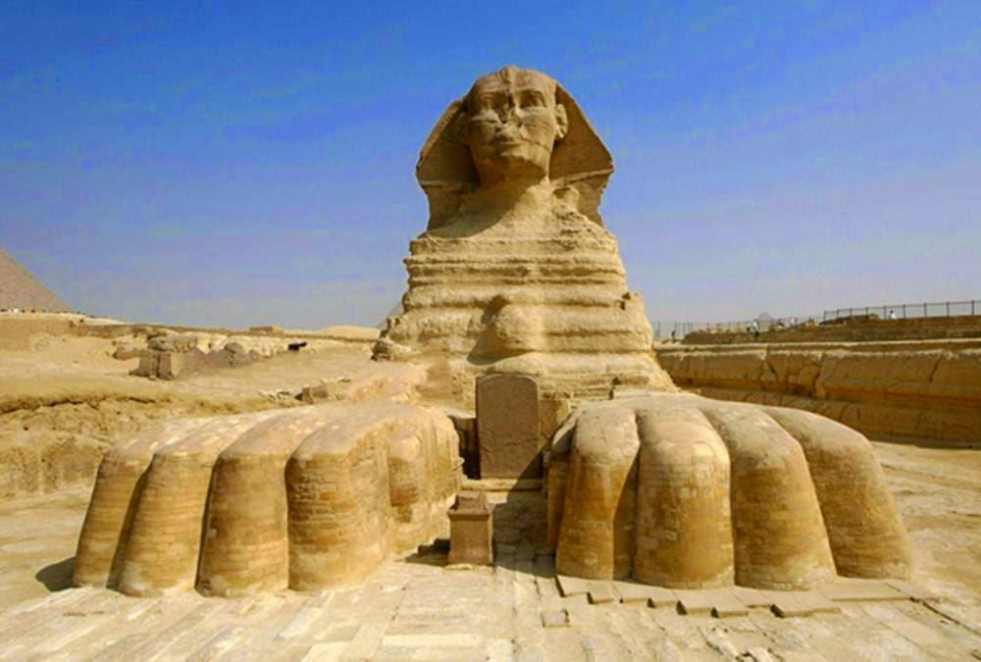
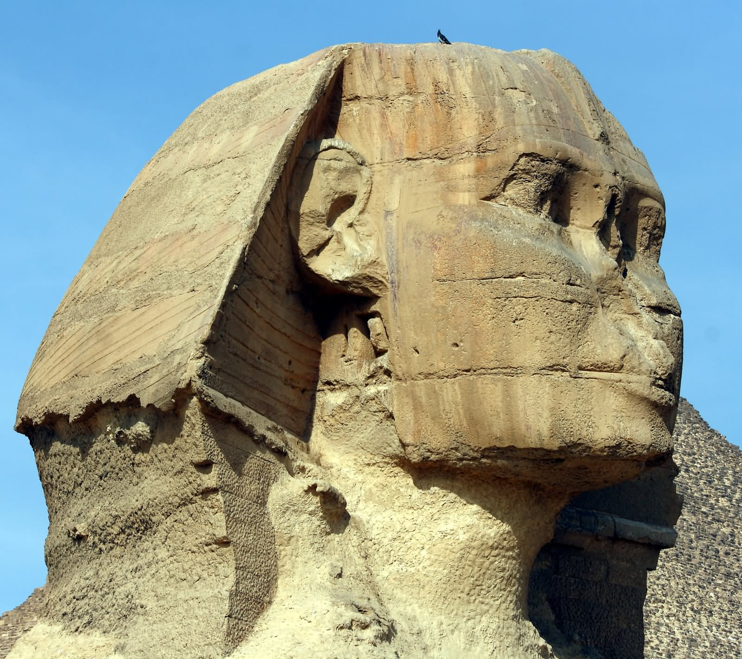
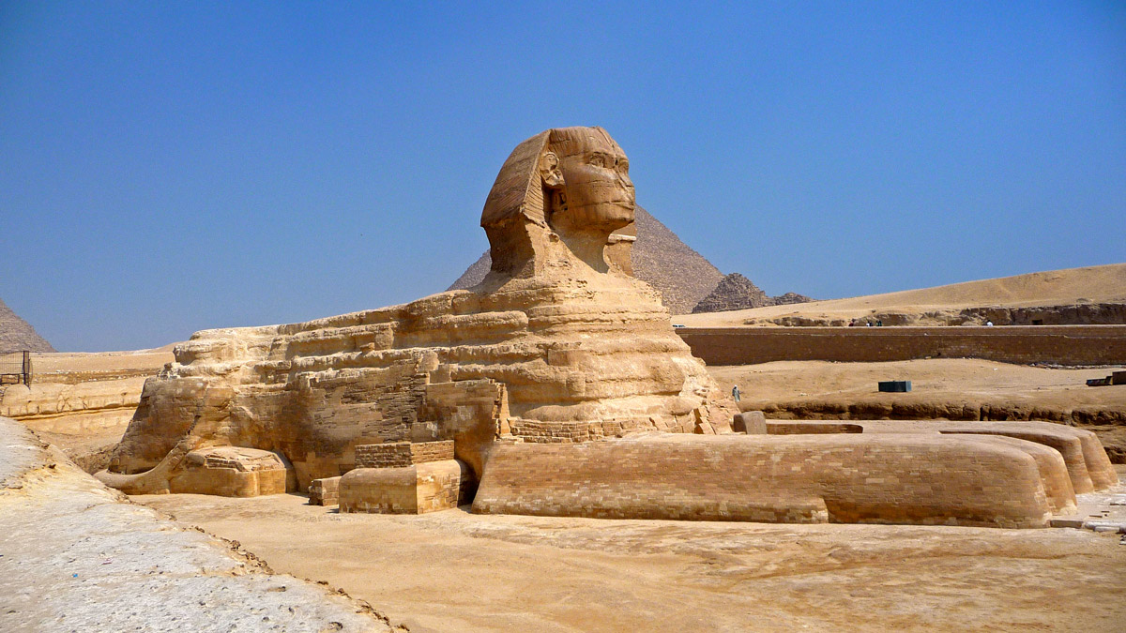
The Great Sphinx

Slide 14
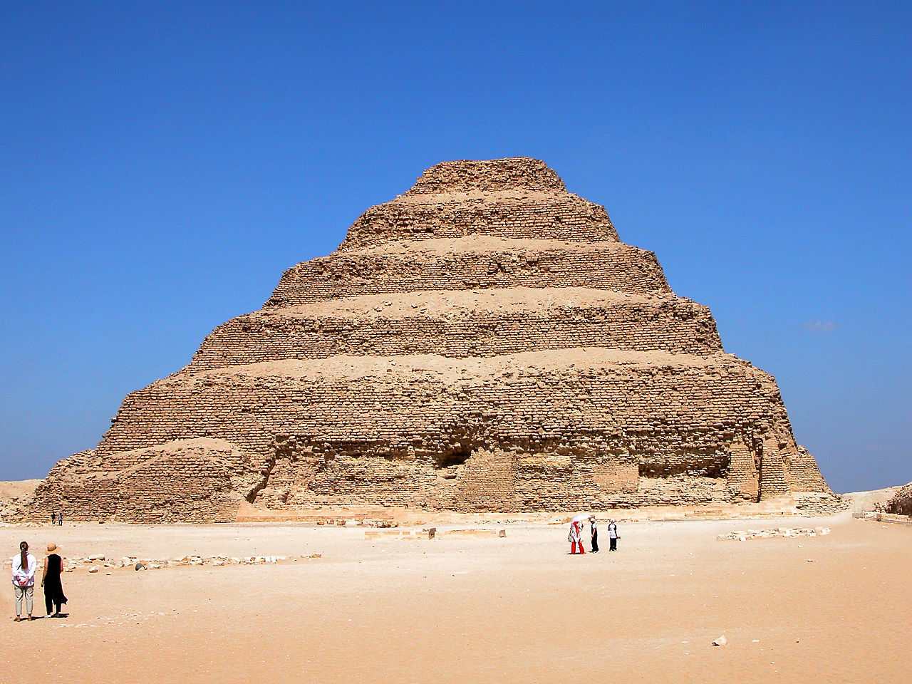
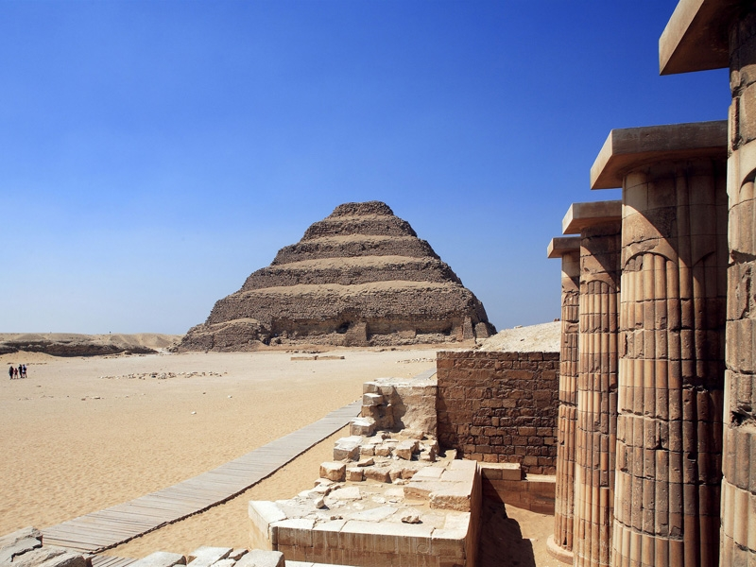
Stepped Pyramid of King Zosar, Saqqara

Slide 15
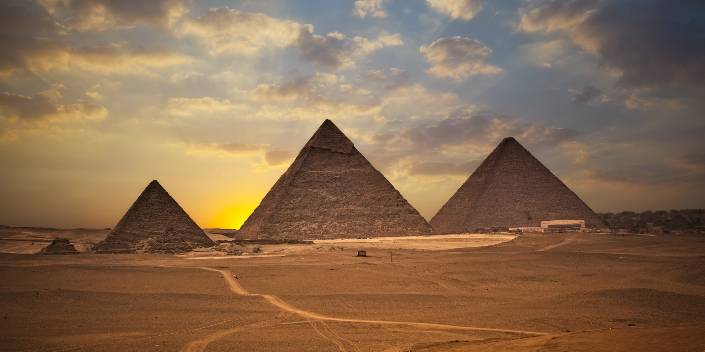
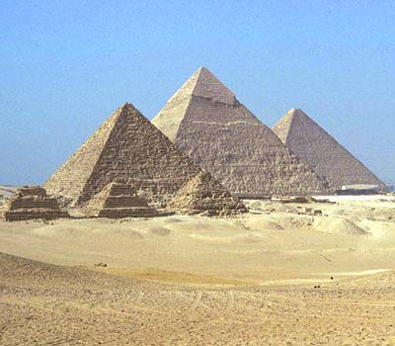
The Great Pyramids at Gizeh
Menkure, Khufu, and Khafre

Slide 16
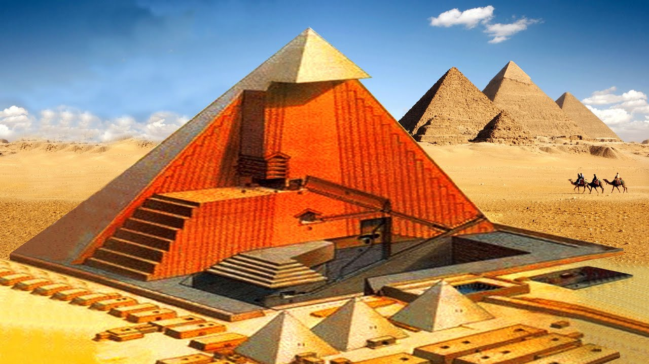
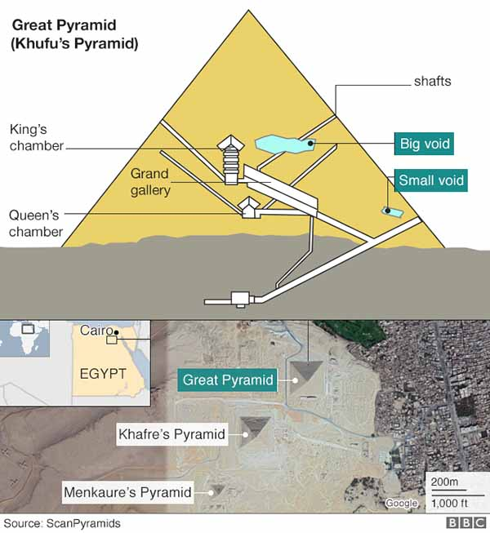

Slide 17
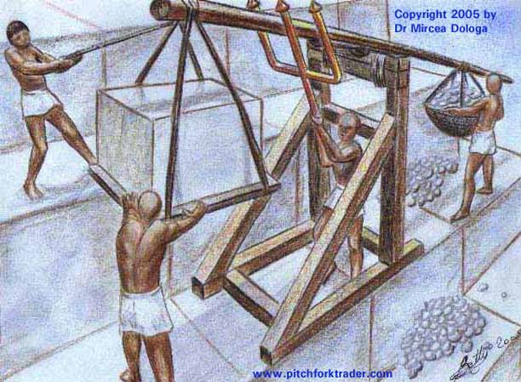
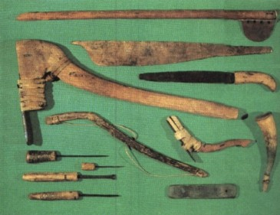
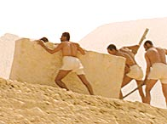


Slide 18
The Visual arts of Ancient Egypt
The art of ancient Egypt comes almost exclusively from tombs and temples. Their art was not intended as decoration; rather, it was created to replicate the living world or to benefit or honor the dead.
Unlike the early cave art of the Neanderthals, the Egyptians had a specific rules for depicting their subjects, based on the social order of the cosmos and their class system. Figures are sized according to a strict hierarchy; with upper-class individuals shown larger than lower-class individuals, and males usually outsizing women and servants.
Very early in Egyptian history, artists developed a set of rules, or canon, to capture the most essential aspects of the subject matter, depicting the upper torso shown from the front, while the lower torso is shown from the side, the head is depicted in profile while the eye and eyebrow is frontal. This method in known as conceptual, based on ideas, rather than visual evidence.
The Egyptian module, or standard of measurement, is represented by a grid system, where the grid is measured into 18-21 equal horizontal units for each figure with 14 vertical lines spaced at the same distance as the horizontals. The distance from the bottom of the foot to the neck/shoulder line equals eight-ninths of the person’s height, and the distance from the bottom of the foot to the armpit equals four-fifths of the person’s height. The grid system was ingenious because it allowed the artist to maintain the same proportions for a figure 12 inches tall and a sculpture 60 feet tall.

Slide 19
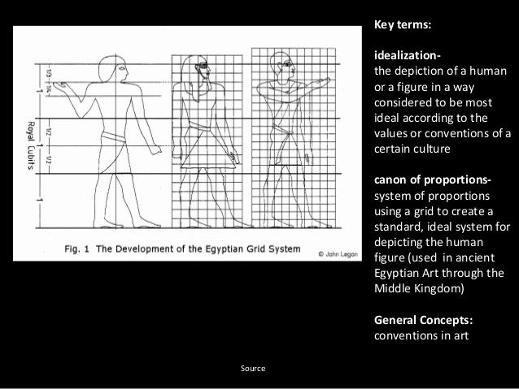
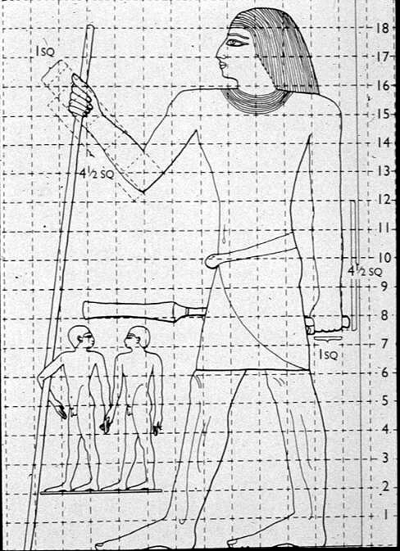
Egyptian Canon Of Proportion

Slide 20
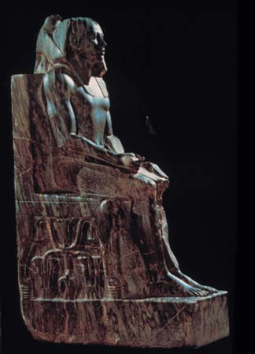
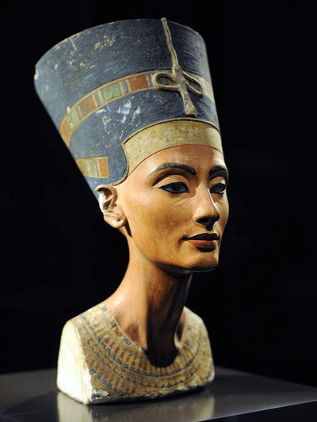
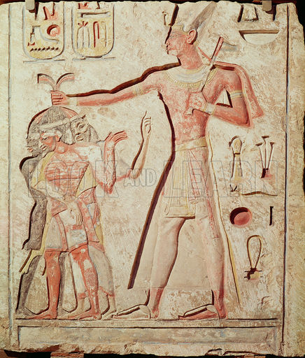
Statue of Chephren
Bust of Queen Nefertiti
Ramesses II Smiting his Enemies

Slide 21
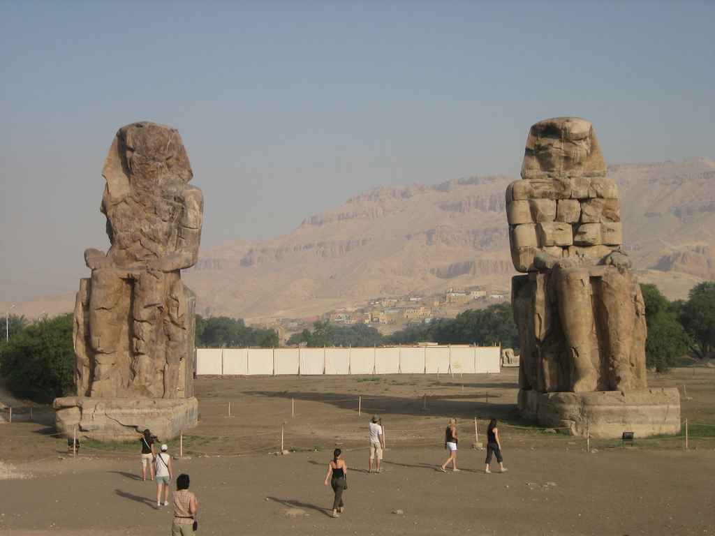
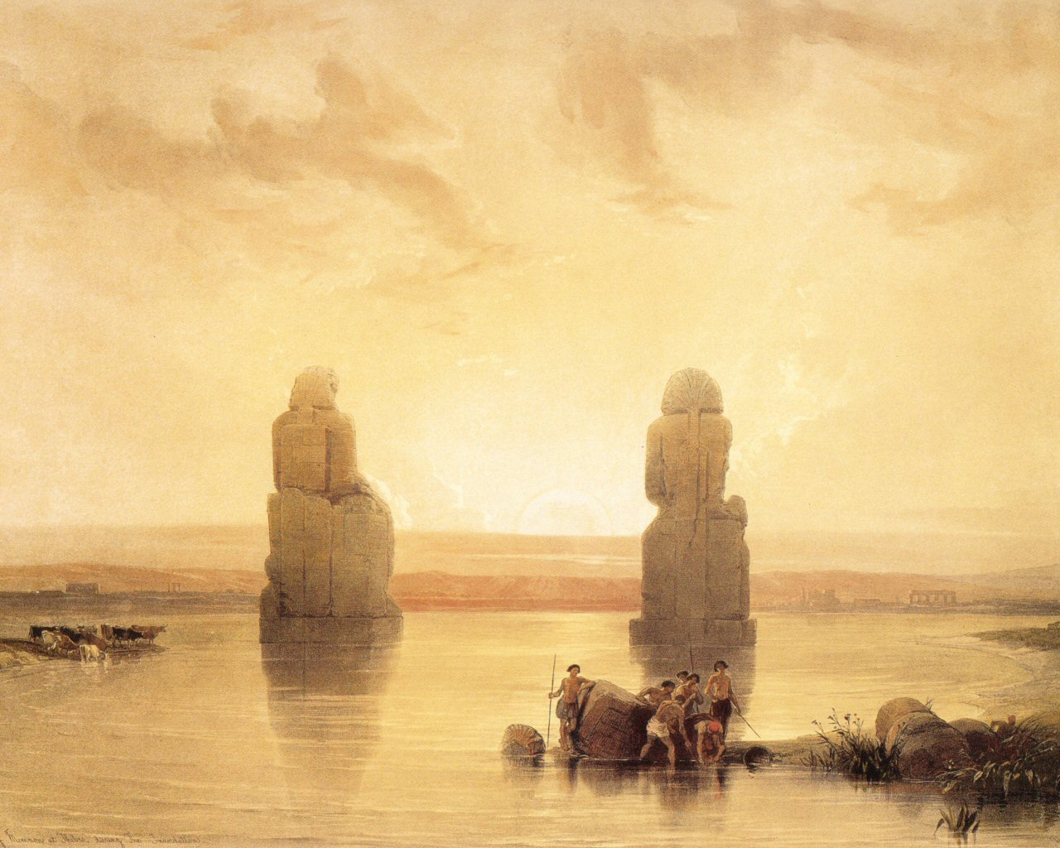
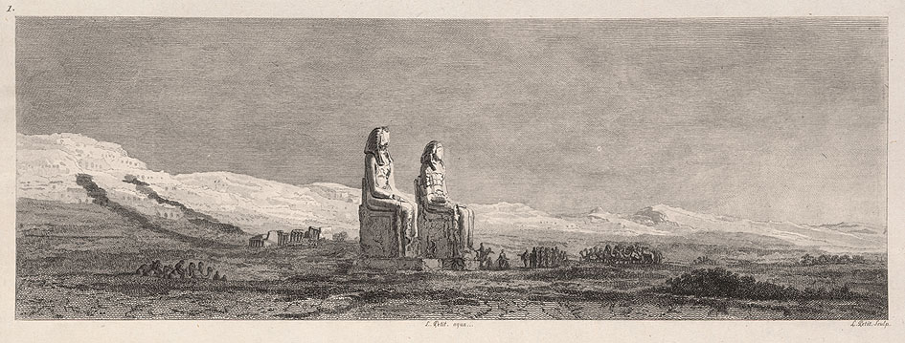
The Colossi of Memnon:
Commissioned by Pharaoh Amenhotep III in 1350 BCE to stand guard at the entrance to his memorial temple.
Situated on 86 acres, just west of the Nile, the statues depict the Pharaoh seated and gazing eastward.
The statues are made of quartzite sandstone and all but the statues themselves were systematically destroyed by flooding.

Slide 22
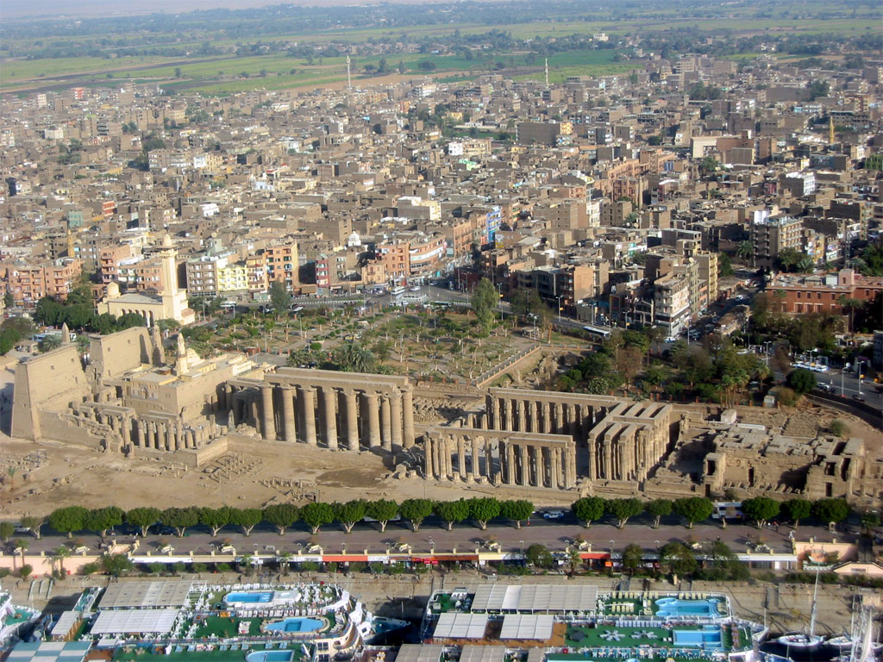
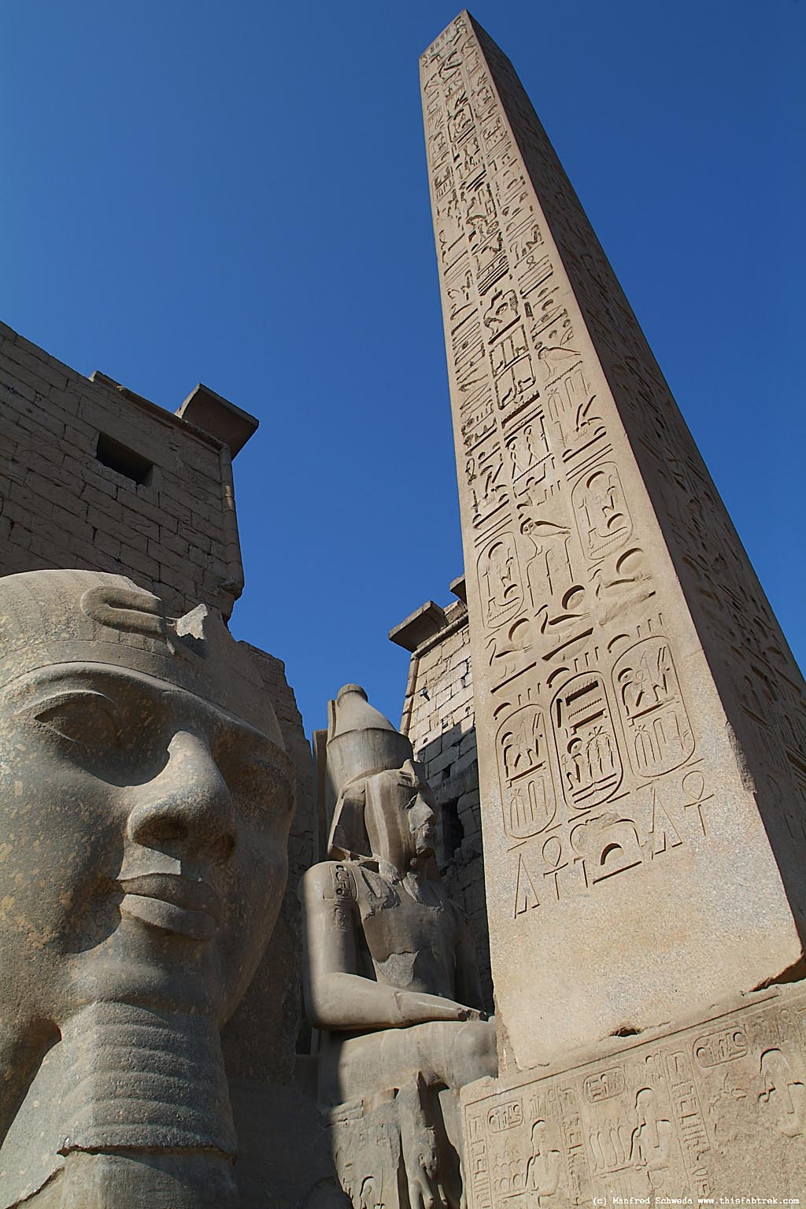
Luxor Temple

Slide 23
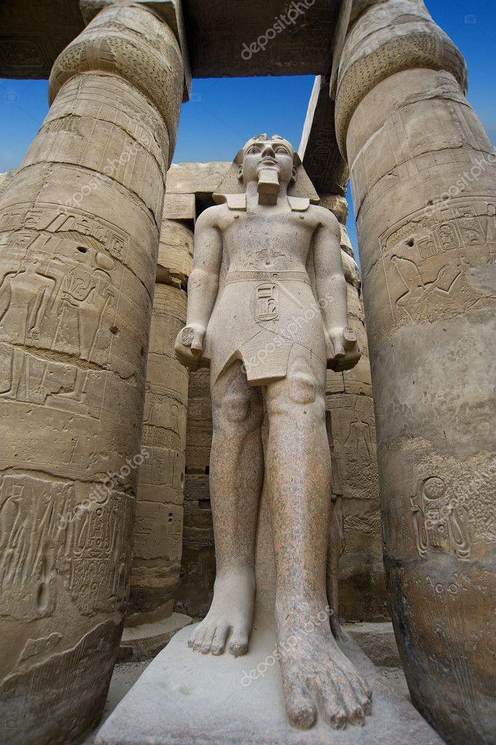
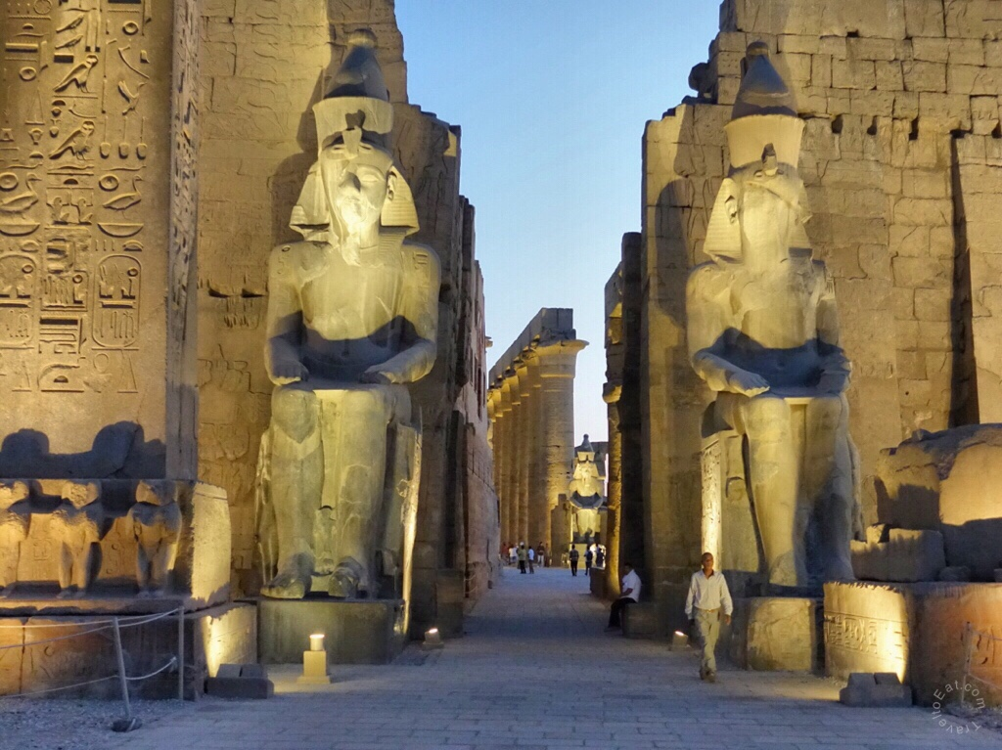

Slide 24
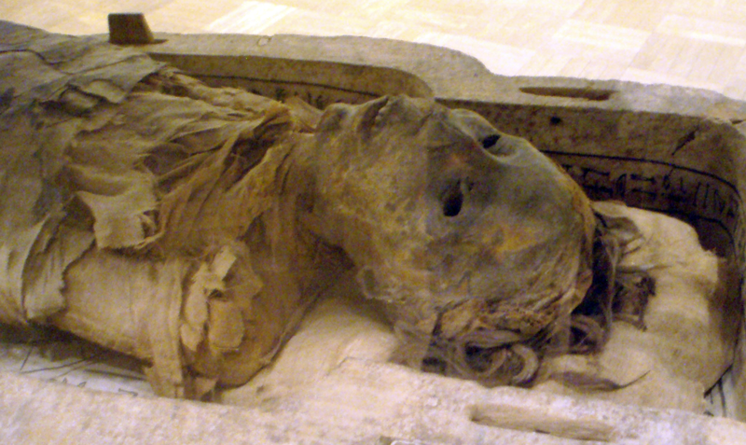
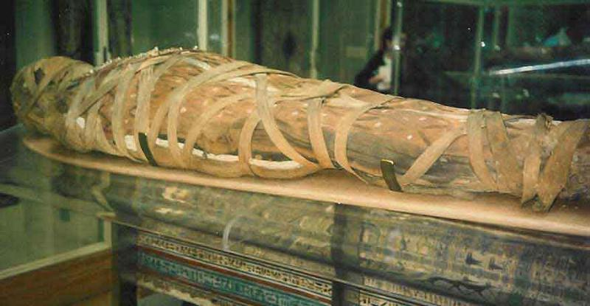
Mummies and Embalming:
Bodies were prepared for burial by means of an embalming procedure that involved removing all of the internal organs, (with the exception of the heart), and filling the body cavity with preservatives.
The intestines, stomach, liver, and lungs were all embalmed separately ( Canopic Jars), and the brain was removed and discarded. The heart was wrapped and placed back inside the body along with a “heart scarab,” an amulet containing a protective spell. The skin was rubbed with molten resin to keep moisture out.
The corpse was then wrapped in hundreds of yards of fine linen and placed in an elaborately ornamented coffin which was floated down the Nile on a barge to the burial site. Less extravagant rituals would be more common for less prominent Egyptians.

Slide 25

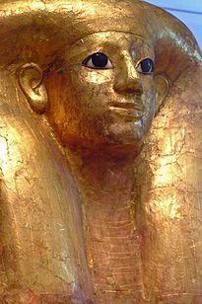
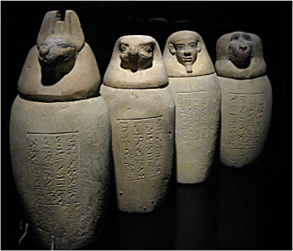
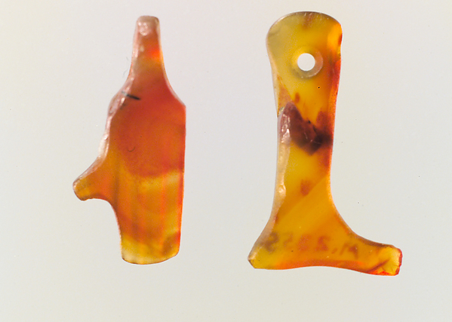
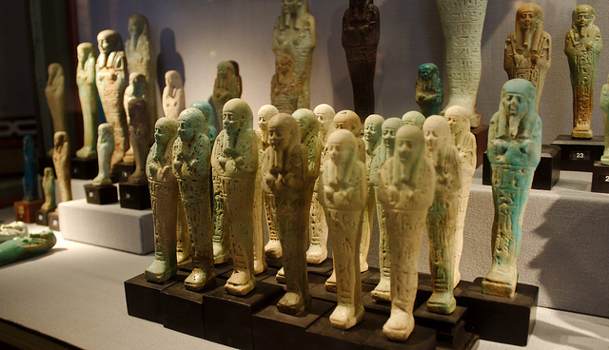
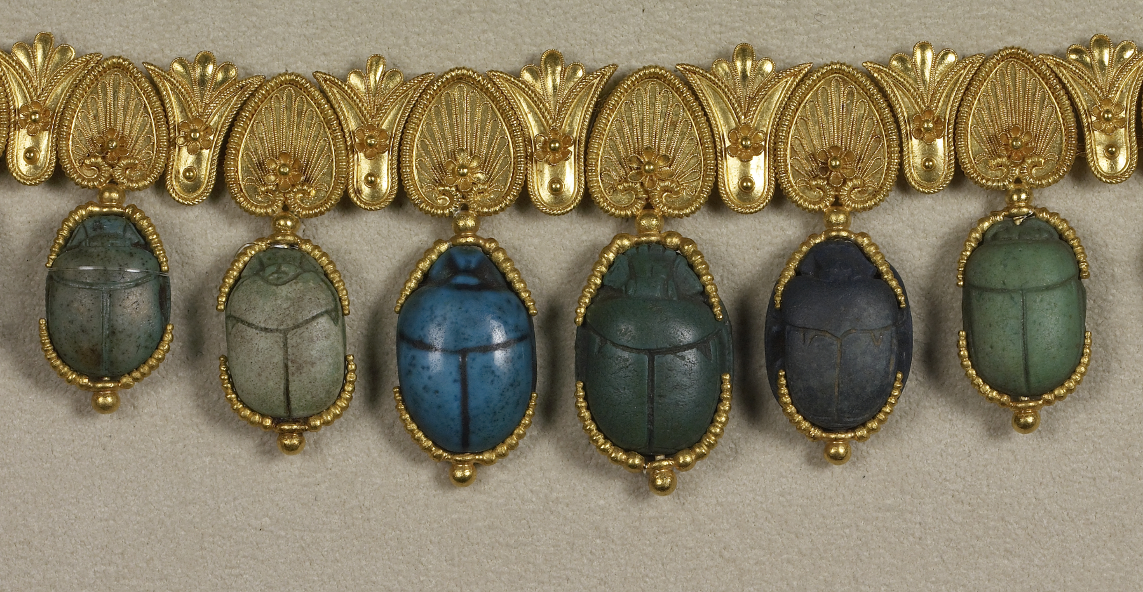
Egyptian Funeral Art:

Slide 26
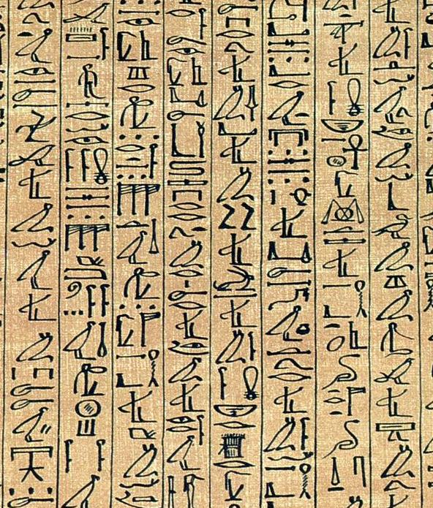
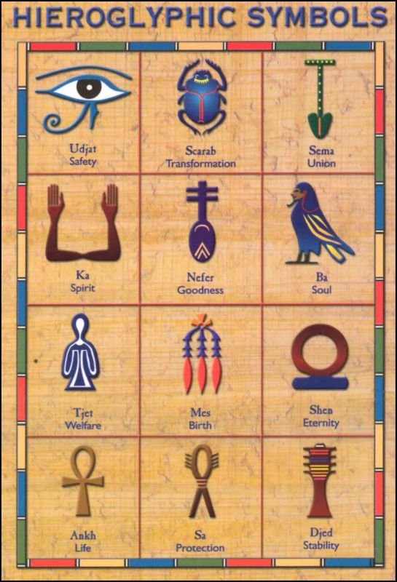
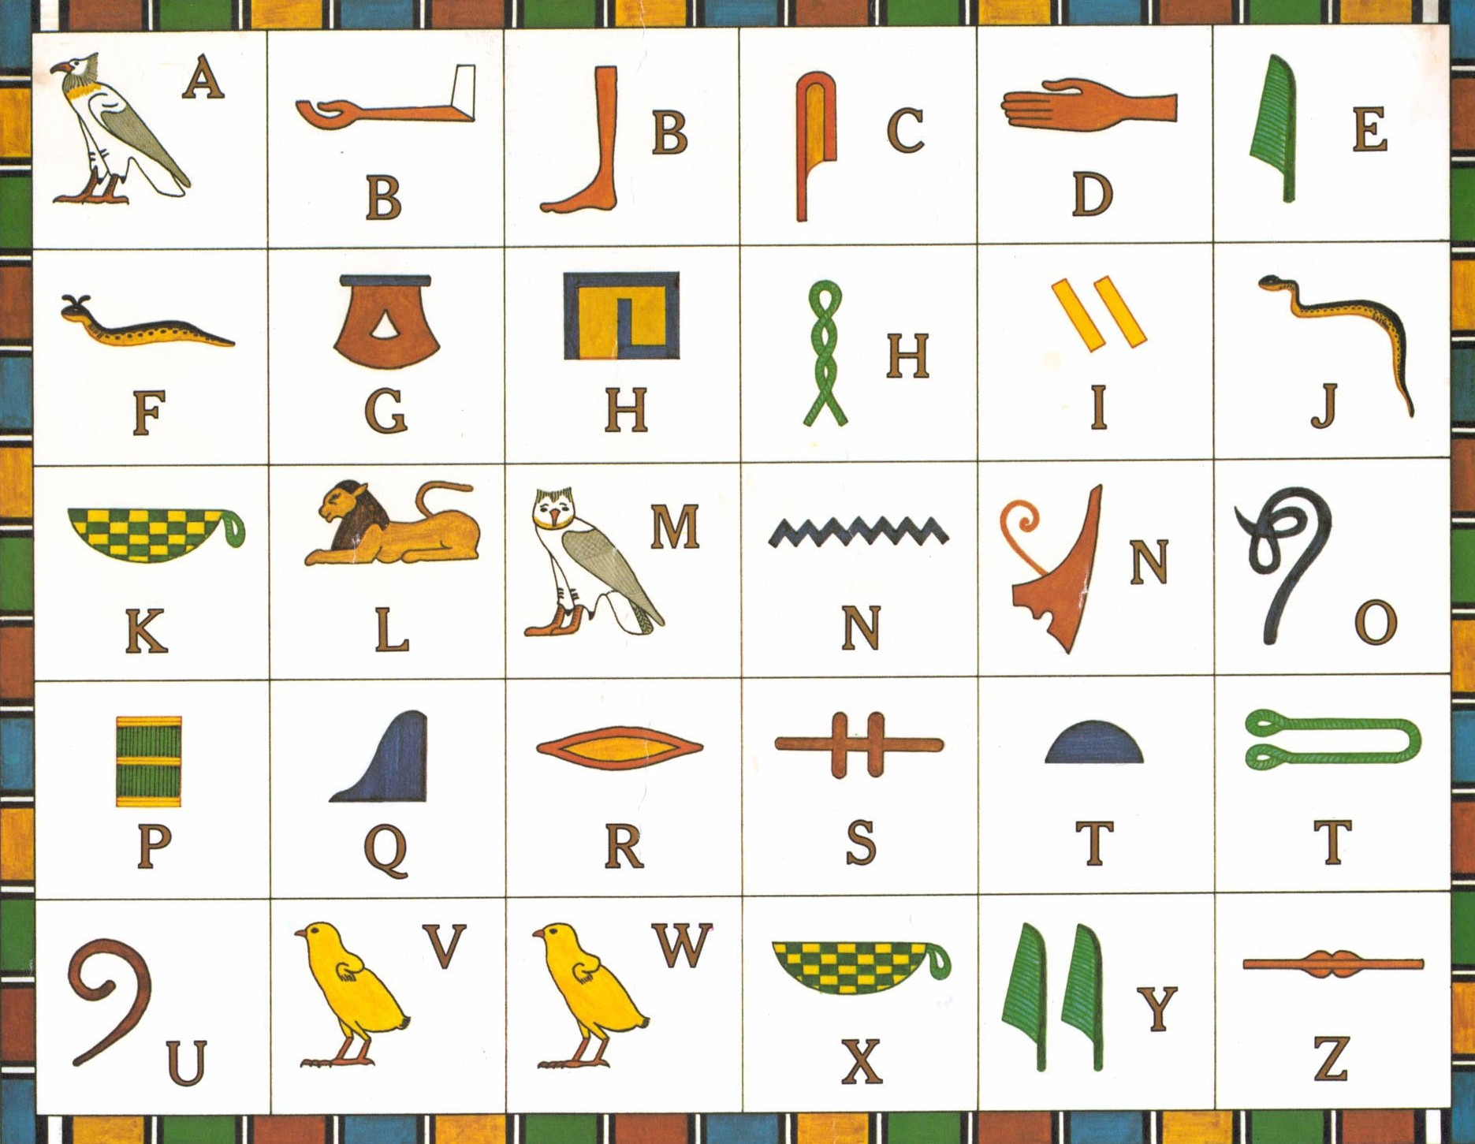
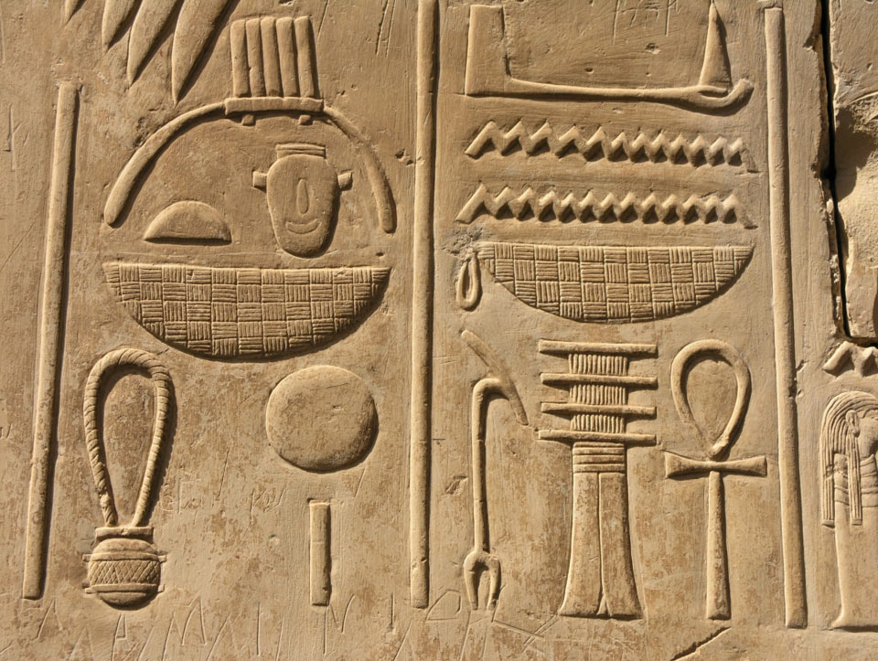
Meaning “sacred carving,” hieroglyphs covered the walls of tombs and temples in stately rows of stylized, repetitious symbols.
Hieroglyphs are elegant decoration, but their main function was to serve as a means of conveying religious texts and praises of their rulers.
Frequently words were expressed both pictorially and phonetically, and the direction of the writing varied according to the requirements of space and symmetry.

Slide 27



African Rock Art:
Graceful human figures
Colorful animals
Motion
Therianthropes- figures with both human and animal characteristics

Slide 28




Slide 29
Egypt’s Social Order
Like many other ancient civilizations, Egypt existed with a high level of cooperation between the people who contributed to communal survival, i.e., governing, trading, farming, and fighting.
The most powerful families, with power usually stemming from victory in battle, often claimed decent or association with the gods, and once this godly authority was established, it was hard to destroy.
For well over 2000 years, Egypt’s large land owners and priests constituted the pharaoh’s bureaucracy, or upper class, by collecting taxes, regulating public works, and mobilizing their army.
Merchants, traders, builders, and scribes made up Egypt’s middle class, and at the bottom of the pyramid, exist the masses of peasants who contributed highly to Egypt’s agricultural backbone. Does this class system sound familiar to today’s set of social order rules?
Egyptian women enjoyed a large degree of economic independence, civil rights and privileges. Says an Egyptian manual of good conduct: “Make her happy while you are alive, for she is land profitable to her lord. Neither judge her, nor raise her to a position of power…her eye is a stormwind when she sees.” Do you think this attitude toward women is a result of the adoration of several female deities or were they just afraid?

Slide 30


Queen (Pharaoh) Hatshepsut

Slide 31




Egyptian Dance:

Slide 32
Egyptian Dance:
As dance is hard to excavate, all of the evidence we have comes from visual art, mostly in tombs.
The Egyptian canon varies slightly when it comes to depicting dancers in tomb art. The conceptual model is used to depict the dead and their family because it was thought that correct artistic representation would help unleash the magic that helped the dead be transported to the next world. AS the dancers were not making that journey, they could be depicted differently.
Dancers were shown in a manner closer to true profile, as well as shown beside and next to each other in an overlapping fashion. Arms may been elongated to make movement look more complete.
Most Egyptian dancers belonged to a professional bureau called a khener. A khener is a group within another institution like palace, temple, town, or household. The members provided music and dance entertainment to whichever institution they were associated with.
Some traditional dances of the ancient Egyptian people included the Heby-Dance, the Iba-Dance, and the Funeral Dance. The Funeral Dance portrayed the five major parts of the Egyptian funeral, including the deceased journey from East to West across the sky with the sun god Ra, the deceased arrival in the West, the deceased rebirth in the House of Purification, judging the deceased’s previous life in the House of Embalmment, and the depositing the mummy in he tomb. Cult dances utilizing acrobatics were used often to worship the goddess Hathor.

Slide 33
Egyptian Music:
Egyptians never described their music in the texts they wrote, though there are some references to music and musicians in Egyptian literature. The absence of musical notation means the sound of the ancient music as it existed then, has irretrievably lost to modern ears. Having said that, most of what can be known about Egyptian music comes from representations in temple and tombs.
These tomb and temple drawings present evidence that Egyptian laborers integrated music with their labor, creating “work songs,” as well as “call and response” songs to entertain themselves while working in the agricultural sector.
Men and women both worked as musicians in Egyptian society. Some instruments however, were gender-designated. Only men played the single and double flutes and oboes, while women played the shoulder harp, frame drums, clap sticks, and the sistrum.
Singing, another musical expression open to either sex, was so fundamental to almost every performance that the instrumentalists functioned either as accompanists to other singers or to themselves if they were singing.
The main Egyptian deities associated with music are Hathor and Bes.

Slide 34







Slide 35




Slide 36








Slide 37




Slide 38





Slide 39



Slide 40


India, China, and the Americas
“He knows peace who has forgotten desire.
He lives without craving:
Free from ego, free from pride.”
The Bhagavad-Gita

Slide 41
Early Civilizations of India and China
The civilizations of India and China are among the only continuous civilizations in world history: their language, belief systems and many cultural practices flourishing in the same way the did in ancient times.
Different from Western culture, the Asian world view is based in pantheism, or the belief that an all-pervading divine spirit infuses all aspects of the universe.
The Indian Hindu world view is based in henotheism, or the belief in one great spiritual force, without denying other deities.
India and China shared a holistic view of the cosmos, that perceived an intimate relationship between gods, rulers, and the social order.

Slide 42
Ancient India-Indus Valley 2700-1500 B.C.E.
India’s earliest known civilization was located in the lower Indus Valley, and was heavily influenced by both Egypt and Mesopotamia.
India’s first cities were planned communities, laid out in grid patterns, similar to the way modern day Manhattan is laid out. Their high tech sewage systems were unmatched in other parts of the civilized world, with enclosed wells and covered drains, which ran below streets.
Citadels (a fortress that commands the city), sat at high points in each city, and protected their most important buildings like grain storage houses and public wells.
Ancient India also laid claim to a form of written language, although the 400 pictographic signs that constitute their earliest script are still undeciphered.
A highly advanced sculptural tradition in bronze and stone existed in ancient India, mastering the use of the lost-wax method of working bronze.

Slide 43



Dancing Girl, from Mohenjo-daro, Indus valley
2300-1750 B.C.E.

Slide 44
Vedic Era- 1500 to 322 B.C.E.
Sometime after 1500 B.C.E. semi-nomadic tribes known as “Aryans,” (“lords or “nobles”) invaded the Indus valley, and established a set of societal divisions called a caste system. Although the Aryans propagated their own language and practices, they did not wipe out the cultural heritage of the Indus people, creating a sort of amalgam of the two peoples.
Similar to the Egyptian’s class system, the Aryans divided the classes into five principal levels: priests and scholars, nobles and warriors, artisans and merchants, unskilled workers (farmers and laborers), and the Untouchables.
The Aryans are also attributed with introducing Sanskrit, derived from their own Indo-European language, which would become the classic language of India.
Based on bitter wars between competing Aryan families, two great epics were produced; the Mahabharata, (Great Deeds of the Mahabharata), and the Ramayana, (Song of the Prince). The Mahabharata is the world’s longest folk epic recreating the ten-year-long struggle for control of the Ganges valley, occurring around the year 1000 B.C.E. Both epics are treasured resources for much of the poetry, drama, and art produced throughout India’s long history.
Treasured resource for much of the poetry, drama, and art produced throughout India’s long history.

Slide 45
Pantheism and the Hindu Religion overview
Pantheism is the belief that divinity is inherent in all things, and is basic to Hinduism, one of the most ancient of today’s religions.
Hinduism identifies the sacred (God) not as a superhuman personality, but as an objective all-pervading cosmic spirit called Brahman. Brahman is the Hindu term for ultimate reality without change, or eternity, and may be conceived as the Supreme Being or single God.
Unlike the deities of Mesopotamia and Egypt, Brahman is infinite, formless, and ultimately unknowable, and unlike the Hebrew god Yahweh, Brahman assumes no personal or contractual relationship with human kind.
Since all deities absorb the Brahman spirit, Hindus embrace all of the Vedic gods with the same commitment, making the religion slightly different from polytheistic and monotheistic religions of the time. All other deities are considered “helper gods” to, or “reflections” of the Supreme Being, who is evident in all living things.
Just to confuse you…the “Supreme God” can take on different forms, depending on which Indian denomination you are speaking about or the context of the setting. The Supreme Being may be called Brahman in one area, or Vishnu in another.

Slide 46
Hinduism overview continued:
Hinduism, which claims about 800 million practitioners worldwide, is unique among humanities major religions in that it cannot be traced to any specific individual or historical event. Because of this, Hinduism is seen as eternal and unchanging. Scholars believe it arose about 3,500 years ago out of interactions between the conquering Aryans and the already present traditions in India.
This profoundly varied religion places a heavy emphasis on attaining freedom from the perceived world and eliminating ties to the material plane of existence, eventually including one’s personal identity.
Hindu means “Indian.” The religious practices under this name make up the dominant faith in India. Hinduism, in its structure expresses the profound diversity of humanity’s experience of the Divine. It is free of formal doctrine, which enables the religion to show remarkable adaptability in its approach to transcendental experiences.
The Rig Veda, is the earliest and most revered of Hinduism’s holy scriptures, and along with the rest of the Vedas, the Brahmanas, the Aranyakas, and the Upanishads, make up Hinduism’s holy writings.
The Hindu doctrine of reincarnation holds that one is trapped by the cycle of life and death until one attains true realization. The doctrine of karma ensures full accountability for every thought, action and word, as hardships experienced in a current life can be attributed to poor decisions in a previous life.

Slide 47



Hindu Gods- Just to confuse you…
The principal at the heart of the Hindu faith is the idea that accepts God as an absolute reality and as the basis of a constantly changing process.
Members of various Hindu sects worship a dizzying number of specific deities, and follow many different rituals in honor of many gods, however, they see these gods as expressions or symbols of the same unchanging reality.
Brahma is a personification of the creator of the world, which is perpetually destined to last for 2,160,000,000 years before it falls to ruin and Brahma recreates it.
Vishnu has many incarnations, Krishna and Rama being the most common. Vishnu is the preserver god, and is a force of transcendent love.
Shiva symbolizes the various potent forms of the energy of the Ultimate. Shiva embodies both the creative force and the idea of destruction.
Vishnu- Preserver god
Brahma- Creator god
Shiva- Sky god

Slide 48


Brahma
Out of the host of deities that characterized Hindu worship in medieval India, three principal gods dominate: Brahma, Vishnu, and Shiva.
The Hindus honor Brahma, his name signifies the masculine form of Brahman, as creator of the world.
Vishnu
Hindus prize Vishnu as the preserver god. Crowned in pictures, Vishnu holds in his upper right hand a flaming solar disk; his upper left hand displays a conch shell, a reminder of his association with the primeval ocean, but also a symbol of the ancient war trumpet used to terrorize his enemies.
With his lower right hand he makes the mudra of protection, while his lower left hand points to the earth and the sacred lotus, symbol of the cosmic womb.

Slide 49
Shiva
Shiva is the Hindu lord of regeneration. A god of destruction and creation, of disease and death, and of sexuality and rebirth, Shiva embodies the dynamic rhythms of the universe.
While often shown as a dual male and female aspect, Shiva is most commonly portrayed as the Lord of the Dance, an image that evokes the Hindu notion of time, which is cyclical, representing an ever-turning cosmic wheel.
Shiva’s earrings are mismatched to represent the male/female duality. One right hand holds a small drum, the symbol of creation; the second right hand forms the protection mudra; one left hand holds a flame, the symbol of destruction; the second left hand points toward Shiva’s feet, the left “released” from worldliness, the right one crushing a demon dwarf that symbolizes ignorance. Shiva embodies the five activities of the godhead: creation, protection, destruction, release from destiny, and enlightenment.

Slide 50

The Vedas
Translates literally to “sacred knowledge.”
The Vedas are a collection of prayers, sacrificial formulae, and hymns, blending the folk traditions of the Indus valley with those of the invading Aryans. The Vedas also contain geographical information that describes the gradual spread of farmers, and gives information about conflicts with other groups and local life at the time.
Vedic deities are the Sky gods Indra and Rudra, later known as Shiva, the fire god, Agni, and the sun god Vishnu.
The Vedas provide a wealth of information concerning astronomical phenomena and the study of the stars, along with the practice of surgery and dissection , marking the beginning of scientific inquiry in India.

Slide 51

Upanishads
Hinduism is best understood by way of religious texts known as the Upanishads, (which means “sitting near”), some 250 prose commentaries on the Vedas.
Upanishads were orally transmitted and recorded in Sanskrit between the eighth and sixth centuries B.C.E.
While the Vedas teach worship through prayer and sacrifice, the Upanishads teach enlightenment (Moksha) through meditation.
The Upanishads offer no guidelines for worship, no moral laws, and no religious dogma.
One set of guidelines the Upanishads do maintain are related to the subject of death and rebirth. The Hindu expects a succession of lives, or the return of the physical form in various forms. The form the physical self takes on each return is directly related to the level of spiritual purity that the Hindu has achieved by the time of their death.

Slide 52

The Bhagavad Gita:
The Bhagavad Gita is one of the masterpieces of religious thought and Indian philosophy.
The Sanskrit classic is usually elevated to the level of the Upanishads when authoritative Hindu scriptures are discussed. In a nation with many “Bibles,” it has emerged as the popularly revered of them all.
This piece is an epic poem relating the dialogue between the human Prince Arjuna and the beloved Lord Krishna on the eve of a great battle. Krishna imparts spiritual wisdom that reinvigorates the faltering Prince Arjuna. The text emphasizes union with God by means of love, selflessness, and total devotion.

Slide 53
MOKSHA- The Hindu’s Ultimate Goal
According to Hindus, in every human being resides the individual manifestation of Brahman or Atman, which according to the Upanishads, is “soundless, formless, intangible, undying, tasteless, odorless, without beginning or end, eternal, and beyond nature.”
Our Atman, or Self, although housed in our human shell or body, seeks to be one with the Absolute Spirit or Brahman.
The reunion of Brahman, or Absolute Spirit and Atman or Self, is a condition known as Moksha (Nirvana), which is the ultimate religious goal of the Hindus.
This absorption of Spirit and Self requires the rejection of the material world, the mastery of the techniques of meditation, and the practice of spiritual exercises known as yoga.

Slide 54



Karma and the Wheel of Rebirth
The Law of Karma- the collective spiritual energy gained from accumulated deeds, which determines one’s physical state in the next life.
Reincarnation/Wheel of Rebirth- the fate of all Hindus to keep returning to this world in various physical states until they achieve Nirvana.

Slide 55



Making Connections: King Tutankhamen

Slide 56



Making Connections:

Slide 57





Making Connections:

Slide 58

Making Connections:
Rabindranath Tagore was a poet, polymath, musician and artist from India. He reshaped Bengali literature and music as well as Indian art with Contextual Modernism in the late 19th and early 20th centuries.
In 1913 he became the first non-European to win the Nobel Prize for literature. Tagore’s poetic songs were viewed as spiritual and mercurial, however, his elegant prose remain largely unknown outside Bengal.
Say not in grief that she is no more
but say in thankfulness that she was
A death is not the extinguishing of a light,
but putting out of the lamp
because the dawn has come.

Slide 59
Need To Know- Chapters 2 & 3
The Egyptian population shared the following common traits: language, religion, and a lifestyle highly influenced by their natural environment.
Egyptians ran their communities by theocratic socialism, by which the god-governed lands were shared according to the needs of the community.
Egyptian tombs called mastabas, were single-storied and rectangular.
Merchants, traders, builders, and scribes made up the Egyptian middle class.
Egyptian visual art was created to replicate the living world or to benefit and honor the dead.
Egyptian artists worked in the conceptual art method, based on their ideas, rather than visual evidence.
The Asian worldview is based in pantheism, or the belief that an all pervading divine spirit infuses all aspects of the universe.
The innovative sculptural medium contributed to the artistic world by early Asian culture was bronze casting.
The ultimate religious goal of Hindus is called moksha (nirvana).
Early Indian civilizations produced two epics: the Mahabharata and the Ramayana.

